Slide 1
MFE Python Course
Advanced Python Programming, Part 1

Slide 2
Why Python in the Age of AI?

Slide 3
Agent Skills: Python Powers AI
What are Agent Skills?
Folders of instructions, scripts, and resources that equip AI agents with domain expertise
Transform general-purpose AI into specialized agents for specific tasks
Like creating an onboarding guide for a new hire
Why Python Matters
Skills include Python scripts that AI agents execute autonomously
Code provides deterministic reliability that LLMs cannot
Learning Python = building tools AI will use to work for you
Example: PDF Skill
SKILL.md with instructions
Python script to extract form fields
AI runs the script without loading it into context
The New Why
Before: Python for interviews and manual scripting
Now: Python to create tools for human-AI collaboration
Your expertise + Python = AI superpowers

Slide 4
Python Fundamentals

Slide 5
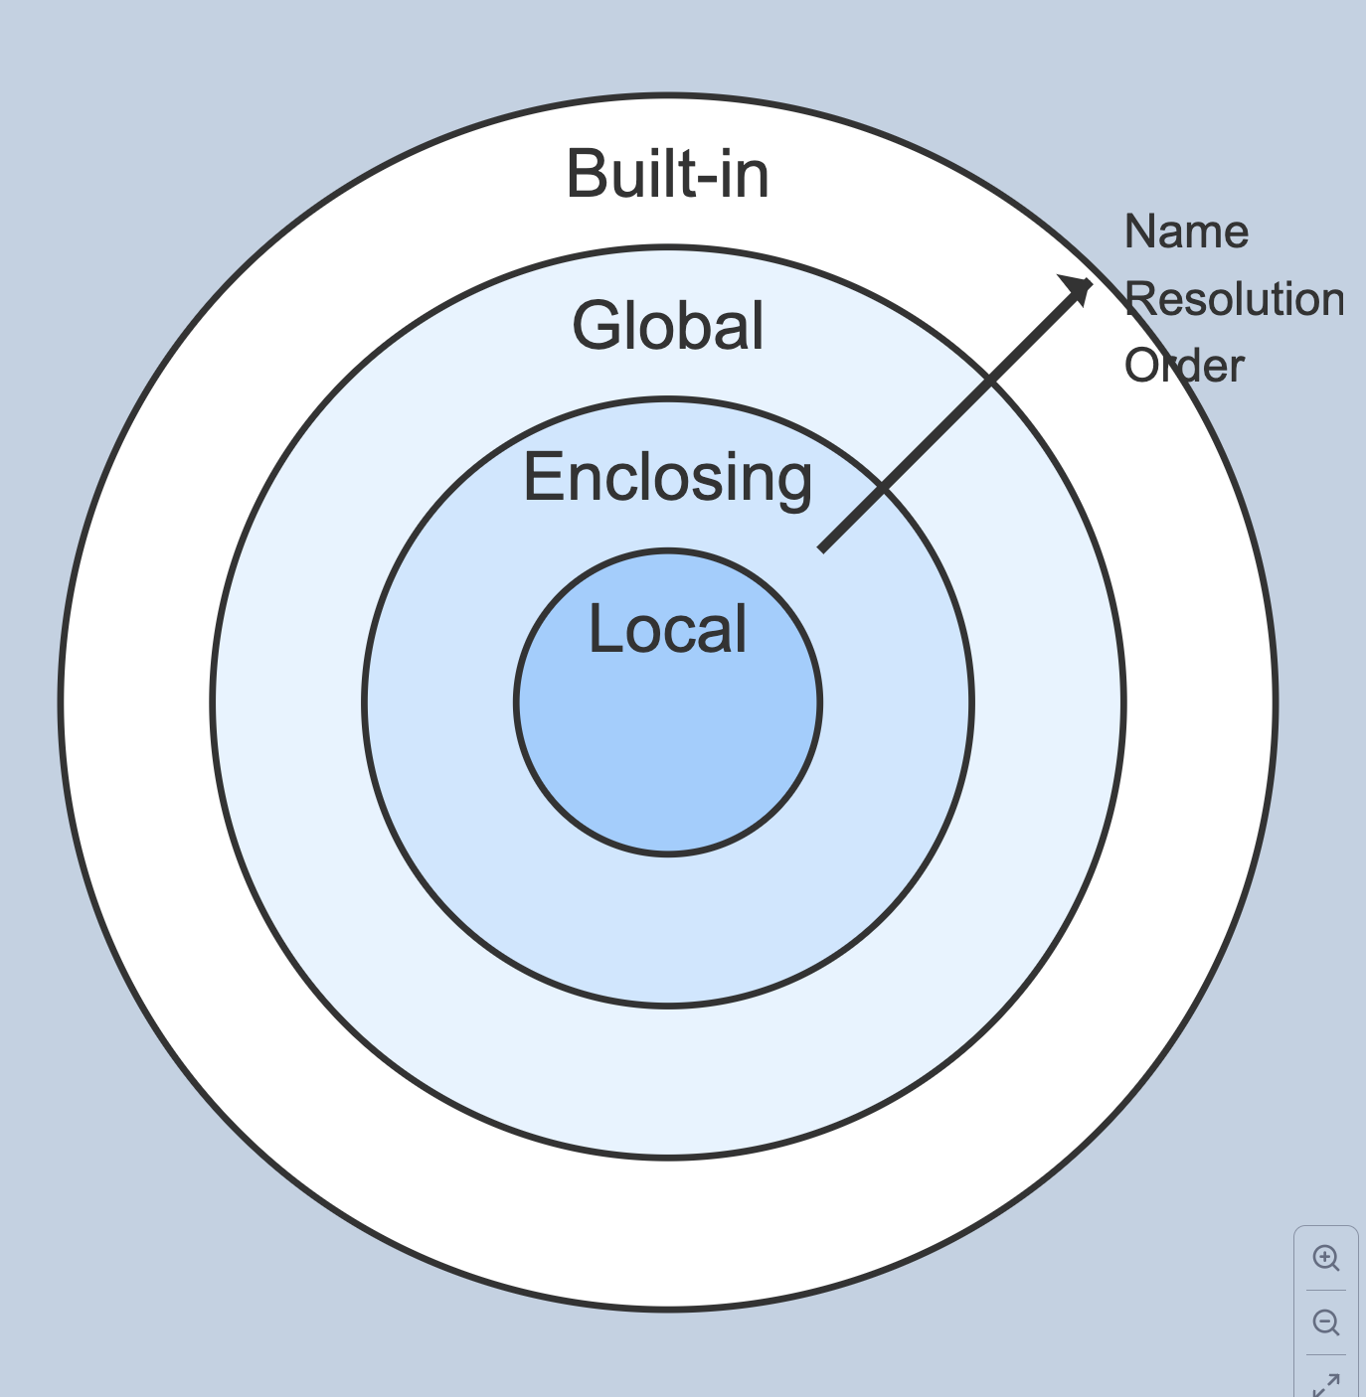
Understanding Scope
Scope is the visibility of variables in your code
LEGB Rule
Local: Variables defined within the current function
Enclosing: Variables in the outer (enclosing) function when working with nested functions
Global: Variables defined at the module/file level, outside of any function
Built-in: Python's pre-defined names like len(), str(), print() that are always available

Slide 6
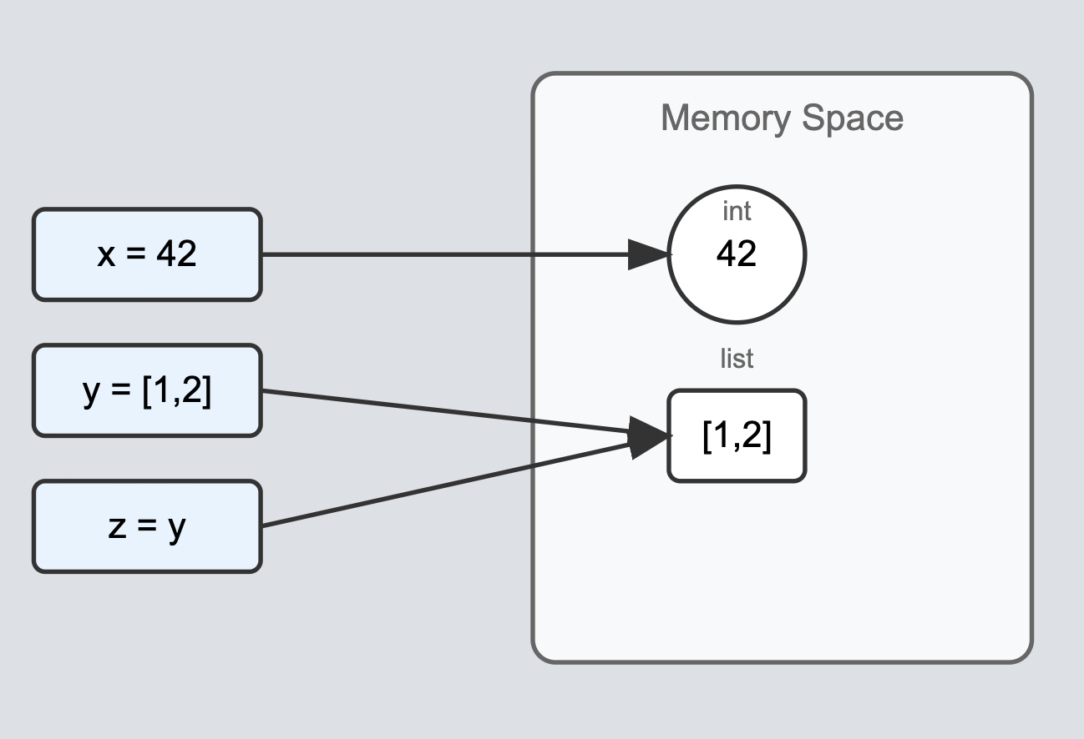
Memory Model Fundamentals
Everything is an object in Python
Numbers, strings, functions, classes, lists - all objects
Each object has an identity, type, and value
Variables are references to objects
Variables act like nametags pointing to objects in memory
Multiple variables can reference the same object
Assignment creates a new reference, not a new object

Slide 7
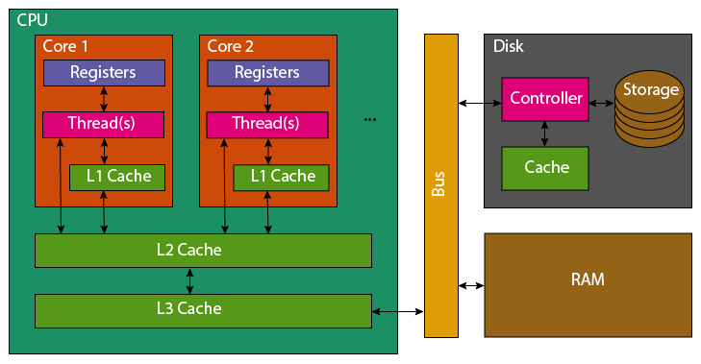

Slide 8
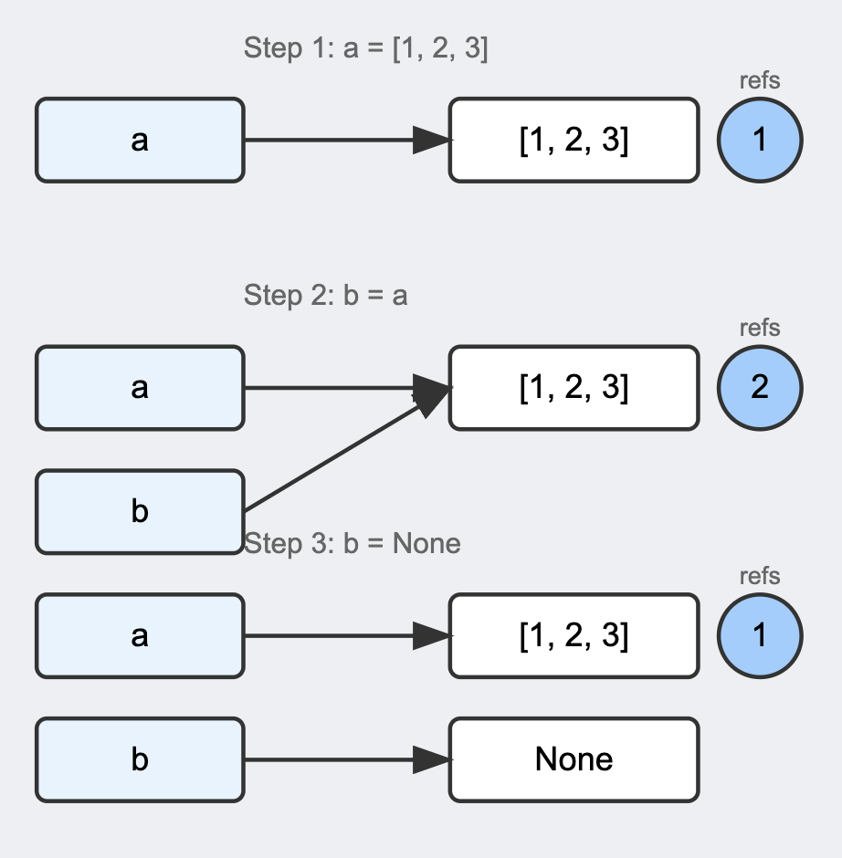
Reference Counting
How Python tracks object references
Each object maintains a count of references pointing to it
Count increases when:
  Variable assignment
  Passing to functions
  Adding to containers (lists, etc.)
Count decreases when:
  Variables go out of scope
  References are reassigned
  Objects are removed from containers
Cleanup (Garbage Collection):
Objects are deleted when reference count reaches 0
Memory is immediately freed - Can be viewed using sys.getrefcount()

Slide 9
Module System Overview
Import Statement Types:
import module
from module import name
from module import name as alias
import module as alias
Module Search Path:
Current directory
PYTHONPATH environment variable
Standard library directories
Site-packages (installed packages)
Key Concepts:
Modules are cached in sys.modules
Imports are executed only once
Circular imports should be avoided

Slide 10
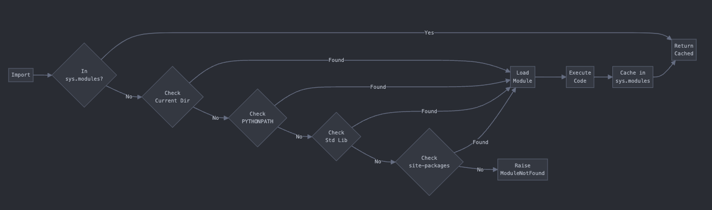
Module System Overview

Slide 11
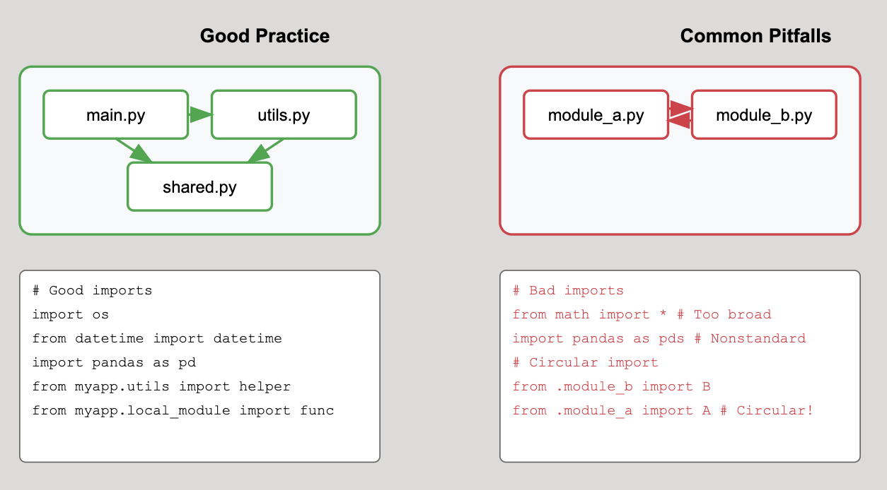
Import Best Practices
What to Import and How:
Be specific: import only what you need
  ✓ from math import sqrt, pi
  ✗ from math import *
Use consistent import style within a project
Group imports logically:
  1. Standard library imports
  2. Third-party imports
  3. Local application imports
Absolute vs Relative Imports:
Absolute imports (preferred) from mypackage.submodule import function
Relative imports (use sparingly) from .submodule import function
Never mix both styles in one project

Slide 12
Import Best Practices
Avoiding Circular Imports:
Restructure: Move shared code to a separate module
Delay imports: Import inside functions when needed
Use dependency injection instead of direct imports

Slide 13
Functional Programming

Slide 14
Functional Programming Intro
What is functional programming?
Code that focuses on transforming data, not changing state
Key Ideas:
Pure Functions: Same input → same output
First-class Functions: Functions as data
When to Use:
Data processing pipelines
Complex transformations
Parallel/concurrent code
Testing-heavy code

Slide 15
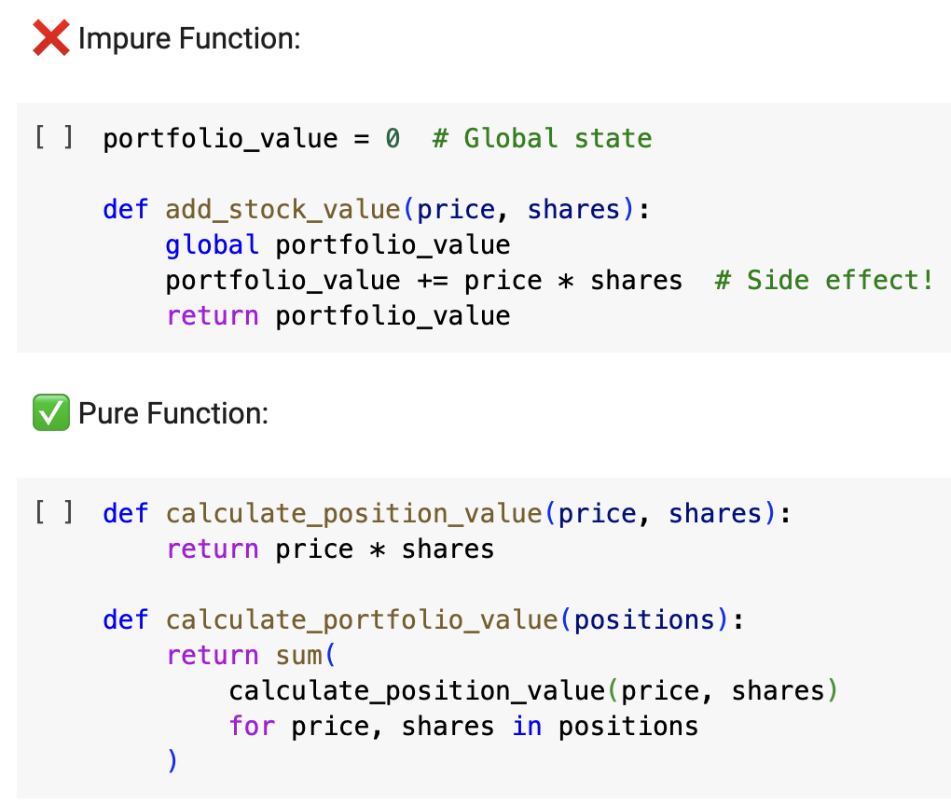
Pure Functions
Characteristics:
Same input → same output (deterministic)
No side effects (doesn't modify external state)
Self-contained (only uses passed arguments)
Example: Portfolio Value Calculation

Slide 16
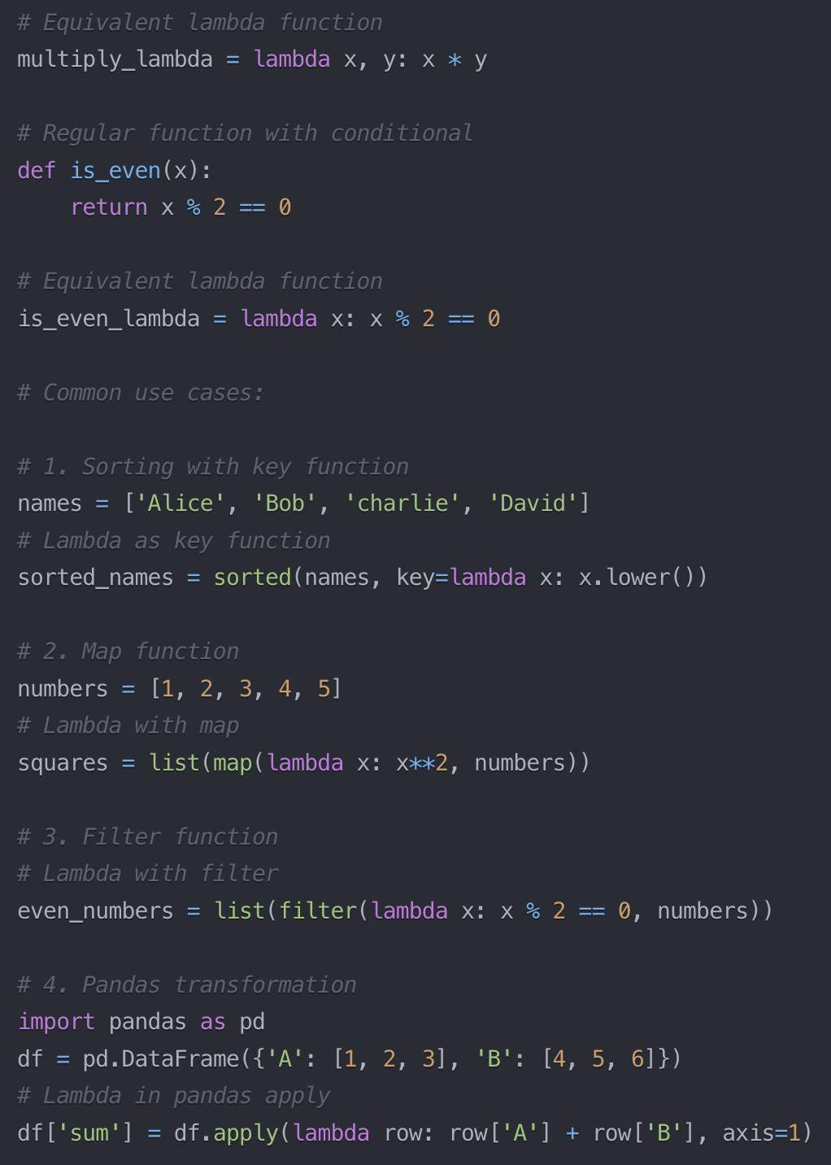
Lambda Functions
What are Lambda Functions?
Single-expression anonymous functions defined using lambda keyword
Create functions without the formal def statement
Automatically returns result of expression - no return keyword needed
Common Use Cases
Sorting with custom keys
Function arguments in higher-order functions (map, filter, reduce)
Quick data transformations in pandas
Simple callbacks and event handlers
Ad-hoc function definitions in list comprehensions

Slide 17
Lambda Functions
Syntax Rules & Limitations
Can only contain a single expression
No assignments or multiple statements allowed
Cannot contain docstrings or type hints
Best for simple operations that can be expressed in one line

Slide 18
Decorators

Slide 19
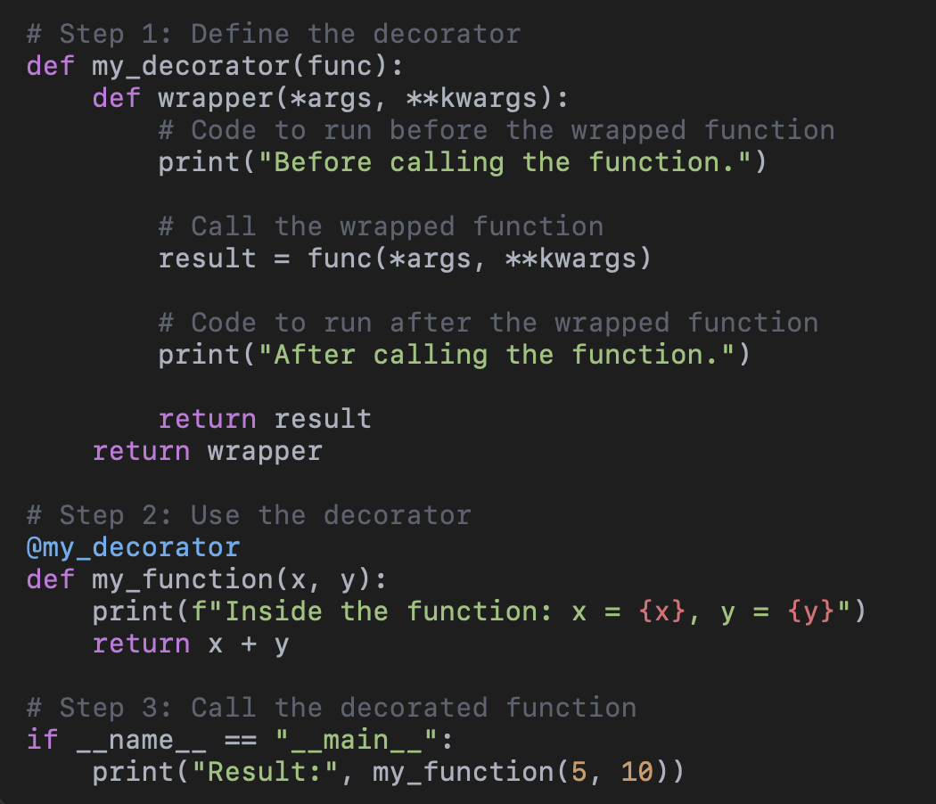
Decorator Fundamentals
What are decorators?
Design pattern that allows modifying function behavior without changing its source code
"Wrappers" that enhance or modify the behavior of functions or classes
Built on Python's ability to treat functions as first-class objects

Slide 20
Decorator Fundamentals
Why use decorators?
Separation of concerns - keep business logic clean
Add functionality without modifying original code
Reduce code duplication
Common uses in finance:
  Performance monitoring
  Input validation
  Logging trade executions
  Caching expensive calculations
  Rate limiting API calls

Slide 21
Decorator Fundamentals
Syntax: @ symbol usage
Syntactic sugar for manually wrapping functions
Places decorator directly above function definition
Can stack multiple decorators
Order of decorators matters (applied from bottom to top)

Slide 22
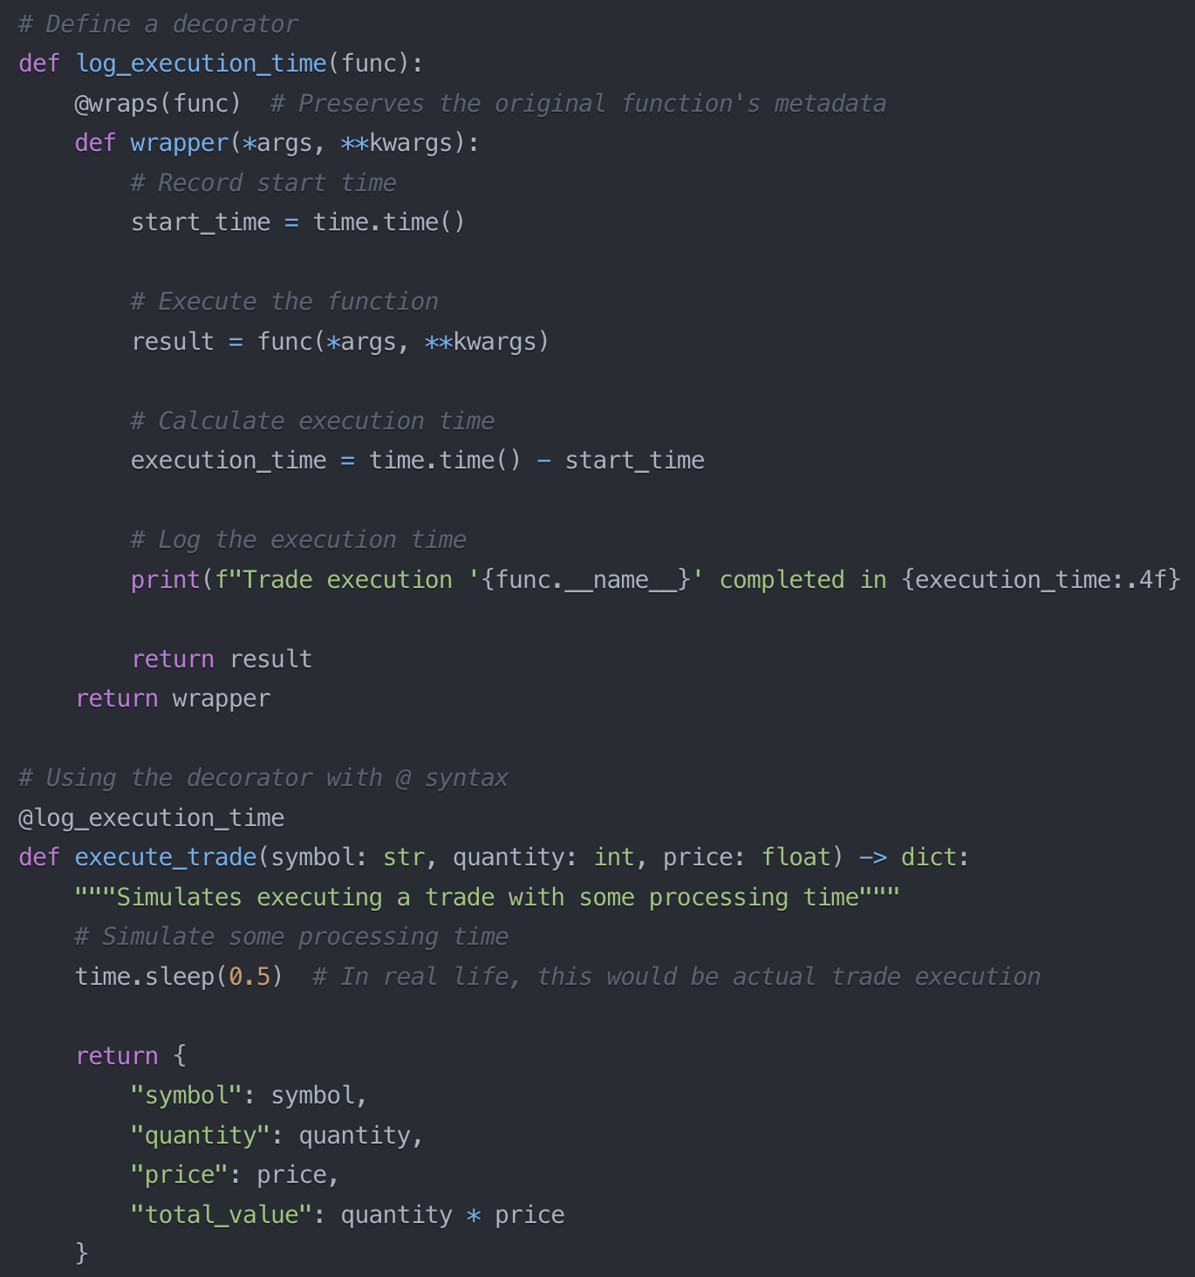
Decorator Mechanics
Functions as first-class objects
Functions can be assigned to variables
Functions can be passed as arguments
Functions can be returned from functions
Functions can be stored in data structures
Common decorator patterns
@validate_input - Check trade size limits, prices
@cache_result - Store expensive calculations
@retry - Auto-retry failed API requests or trades
@rate_limit - Control calls to external services
@requires_permission - Check trade authorization
@log - Measure and record key metrics

Slide 23
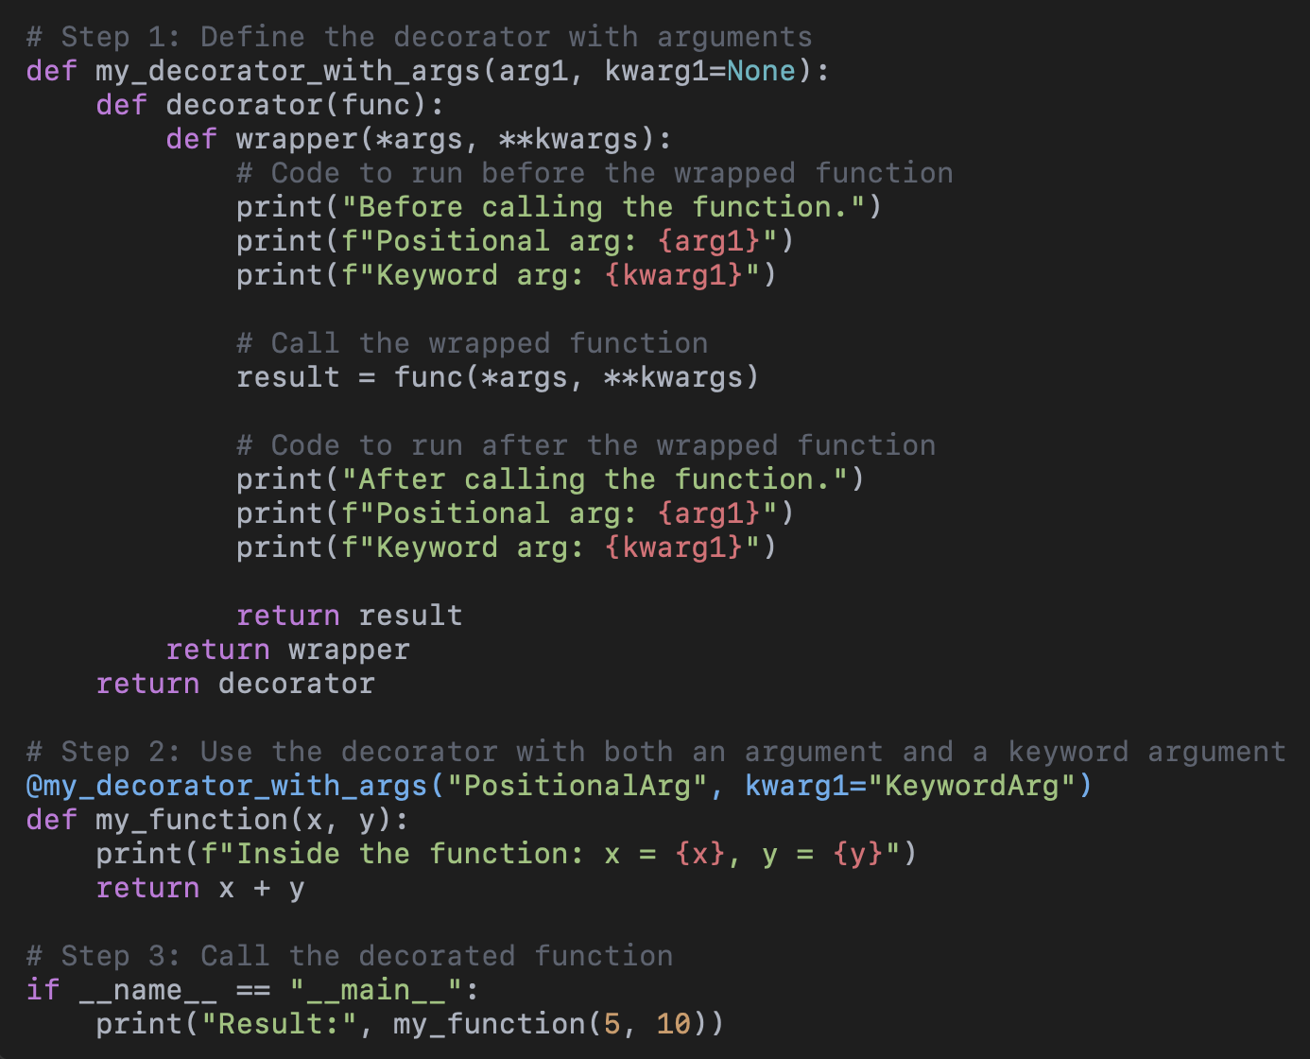
Decorators with Arguments
Layers of a Decorator with Arguments
1. Outer Function (Decorator Factory):
• This function takes arguments that configure or customize the decorator.
• It is called when the decorator is applied to a function.
2. Middle Function (Actual Decorator):
• This function takes the target function (the one being decorated) as its argument.
• It is responsible for wrapping the target function with additional behavior.
3. Inner Function (Wrapper):
• This function actually wraps the target function.
• It executes the additional behavior before and after calling the target function.

Slide 24
Decorators with Arguments
How Wrapping Works
1. Applying the Decorator:
When you use a decorator with arguments, like @decorator(arg1, kwarg1=value), Python first calls the outer function (decorator(arg1, kwarg1=value)). This returns the actual decorator (middle function).
2. Decorating the Function:
The actual decorator (middle function) takes the target function as an argument. It defines and returns the wrapper function.
3. Executing the Decorated Function:
When the decorated function is called, Python executes the wrapper function. The wrapper:
• Executes any pre-function behavior.
• Calls the original function (optionally modifying arguments or results).
• Executes any post-function behavior.

Slide 25
Object-Oriented Programming

Slide 26
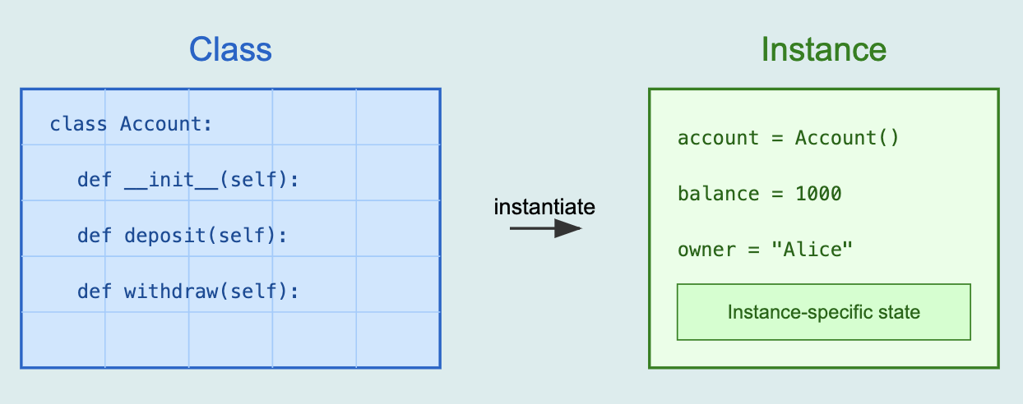
OOP Fundamentals
Classes vs Instances
Class: Blueprint defining attributes and behaviors
Instance: Concrete object created from the class
Python’s object model
Everything is an object (even classes!)
Classes define shared behavior and structure
Each instance maintains its own state
Methods automatically receive self reference

Slide 27
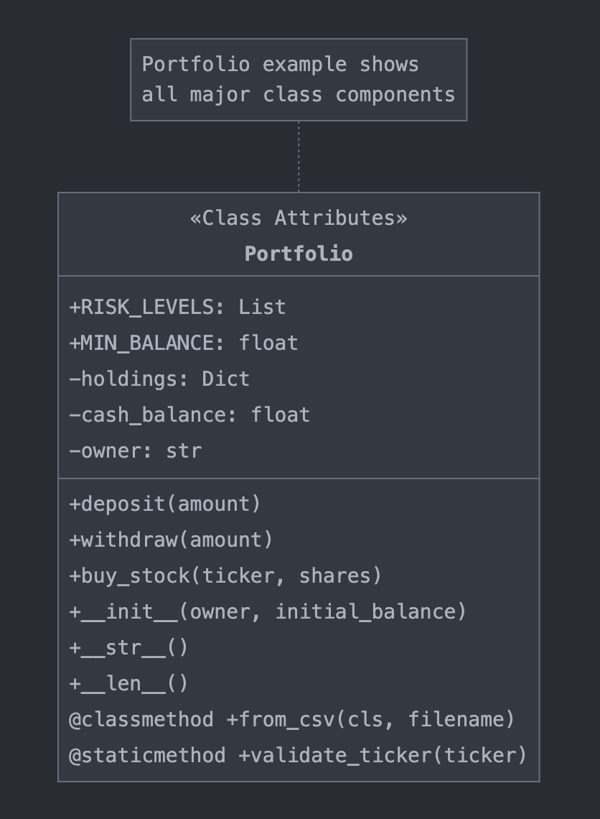
Class Anatomy
Class attributes vs Instance attributes
Class attributes: Shared across all instances
Instance attributes: Unique to each instance
Methods and special methods
Regular methods: Operate on instance state (self)
Class methods: Operate on class state (@classmethod)
Static methods: Independent utility functions (@staticmethod)
Special Methods:
__init__: Constructor
__str__, __repr__: String representations
__len__, __getitem__: Container behavior

Slide 28
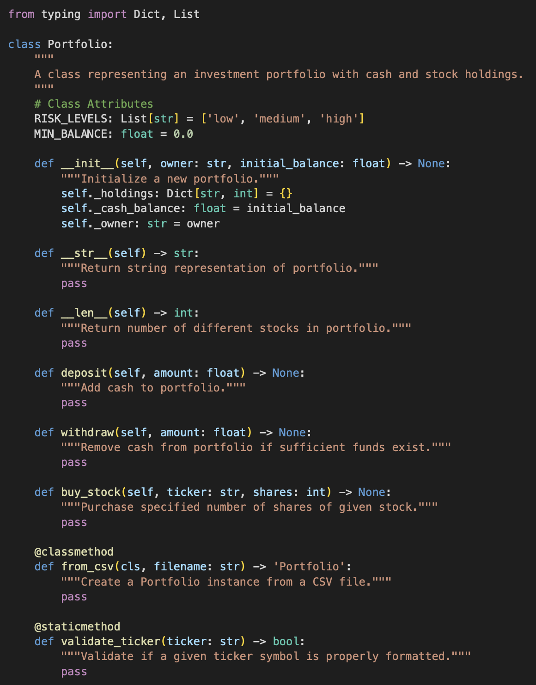

Slide 29
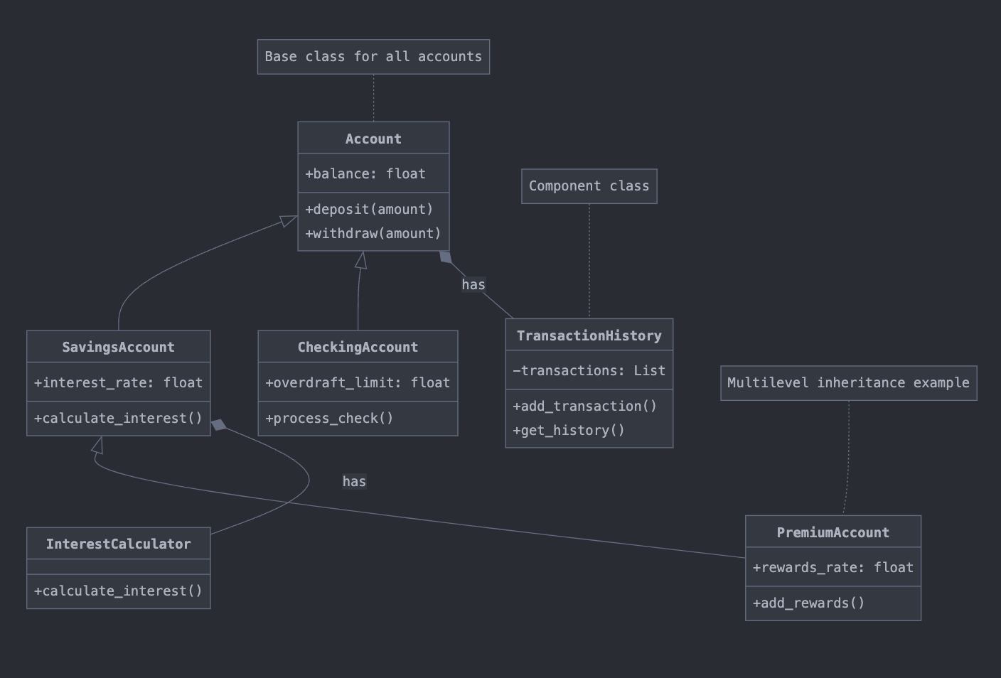
Inheritance & Composition
Types of inheritance
Single inheritance: Class inherits from one base class
Multiple inheritance: Class inherits from multiple base classes
Multilevel inheritance: Class inherits from a derived class
Composition vs. Inheritance
Inheritance: "is-a" relationship (SavingsAccount is-a Account)
Composition: "has-a" relationship (Account has-a TransactionHistory)
Best Practice:
Use inheritance for specialization
Use composition for building complex behaviors
Prefer composition over inheritance when in doubt

Slide 31
Type Hints & Interfaces
Abstract Base Classes (ABCs):
Define interface contracts using @abstractmethod
Cannot be instantiated directly
Force subclasses to implement required methods
Enable strong type checking and consistency
Type Hint Syntax:
Basic types: str, int, float, bool
Container types: List[str], Dict[str, float]
Union types: Optional[float], Union[str, int]

Slide 32
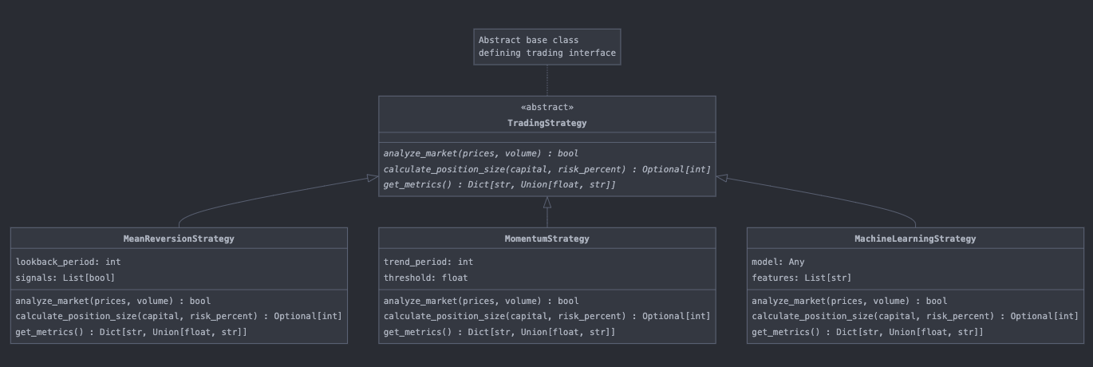
Type Hints & Interfaces

Slide 33
Iterators & Generators

Slide 34
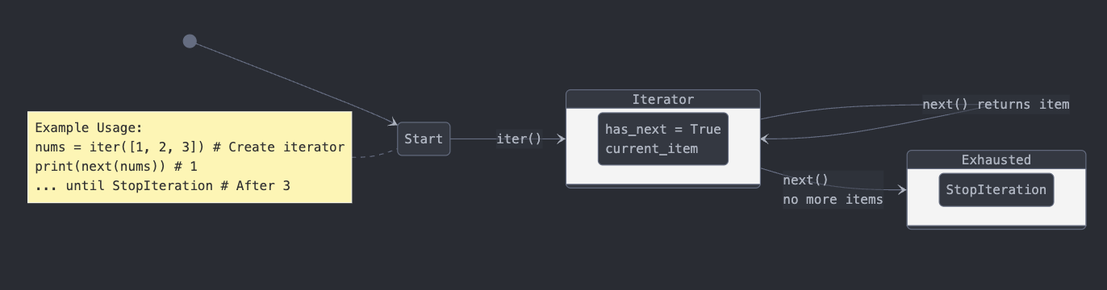
Iterator Protocol
Iterator vs Iterable:
Iterable: Object that can be "iterated over" (__iter__)
Iterator: Object that keeps state and iterates (__next__)
each time
Built-in Iterators:
range(): Numeric sequences
enumerate(): Index-value pairs
zip(): Parallel iteration
map(): Transformed items

Slide 35
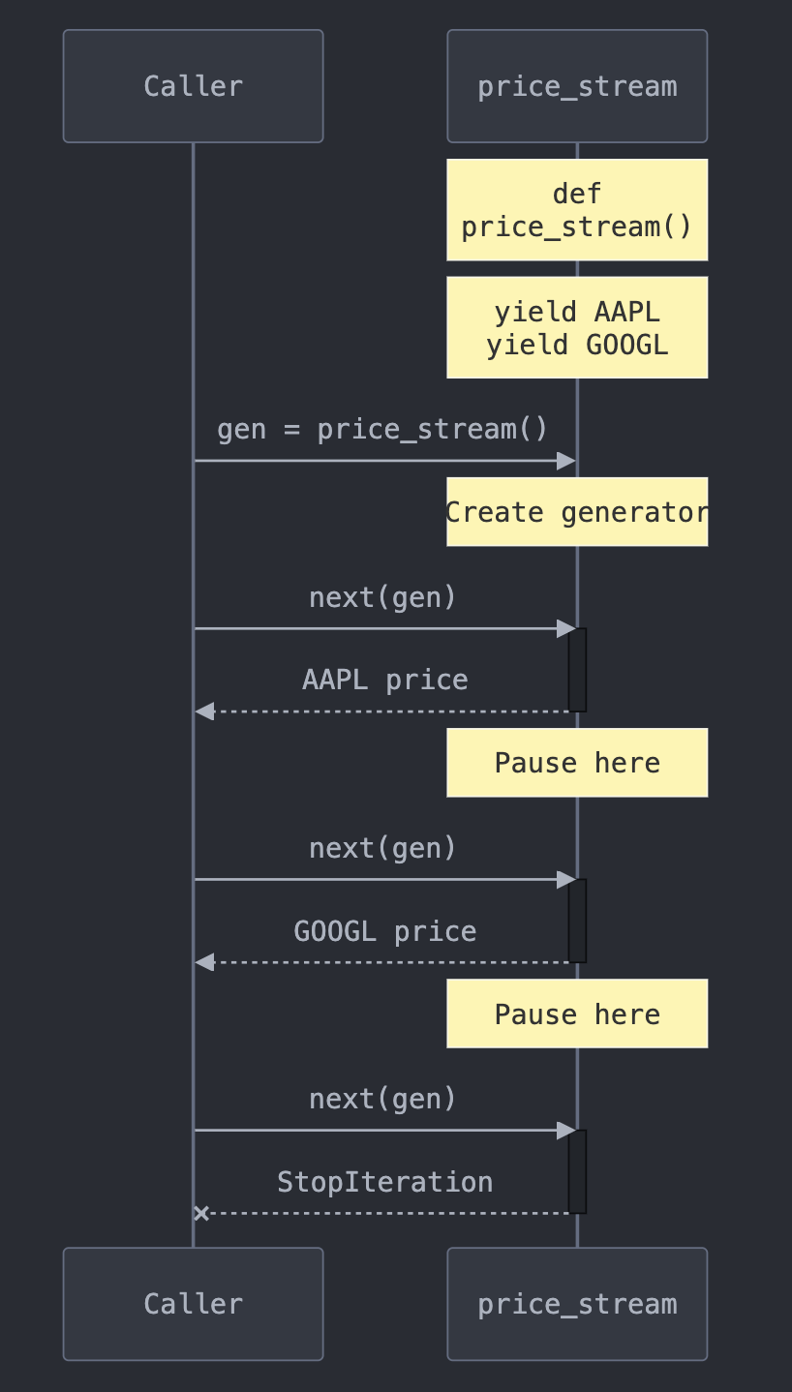
Generator Functions
Yield Statement:
Pauses function execution and returns value
Maintains function state between calls
Memory efficient - generates values on demand
Generator Expression:
Like list comprehension but with () instead of []
Lazy evaluation - computes only when needed
Better memory usage for large sequences
Key Difference:
List comp: [x*2 for x in range(1000000)] # Creates full list Gen exp: (x*2 for x in range(1000000)) # Creates generator

Slide 36
Summary
Key concepts covered
Next steps
Preview of Advanced Python II

